Slide 1
RNN-Based Text Summarization
Worked Example

Slide 2
Encoder Decoder RNN
The encoder RNN reads and understands the document, while the decoder RNN generates the summary word-by-word.

Slide 3
Step 1 — Tokenize the Input
Input: The university organized a technology conference.
For simplicity, consider a smaller sentence:
Students attended the technology conference
Position | Word
1 | Students
2 | attended
3 | the
4 | technology
5 | conference

Slide 4
Step 2 — Convert Words to Vectors
Word | Embedding
Students | [0.5, 0.2]
attended | [0.1, 0.6]
the | [0.2, 0.1]
technology | [0.7, 0.8]
conference | [0.6, 0.5]
x1 = [0.5,0.2]
x2 = [0.1,0.6]

Slide 5

Step 3 — Encoder RNN
The encoder processes one word at a time.
h_{t​}=tanh(W_{x}​x_{t​}+W_{h}​h_{t−1}​+b)
where:
x_{t} = current word vector
h_{t} = current hidden state
h_{t-1} = previous hidden state
W_{x} = input weight
W_{h} = recurrent weight
b = bias
$$wx =\left(\begin{matrix}0.5 & 0.1 \\ 0.2 & 0.4\end{matrix}\right)$$
$$wh=\left(\begin{matrix}0.3 & 0.2 \\ 0.1 & 0.3\end{matrix}\right)$$
$$h0=\left(\begin{matrix}0 \\ 0\end{matrix}\right)$$

Slide 6
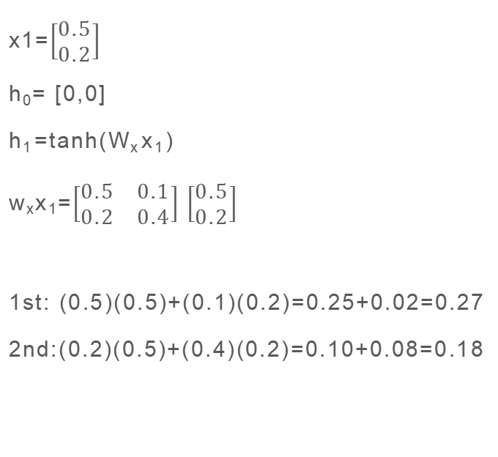
Step 4 — Calculate First Hidden State
x1=$\left[\begin{matrix}0.5 \\ 0.2\end{matrix}\right]$
h₀= [0,0]
h₁​=tanh(W_{x}​x₁​)
w_{x}x₁=$\left[\begin{matrix}0.5 & 0.1 \\ 0.2 & 0.4\end{matrix}\right]$ $\left[\begin{matrix}0.5 \\ 0.2\end{matrix}\right]$
1st: (0.5)(0.5)+(0.1)(0.2)=0.25+0.02=0.27
2nd:(0.2)(0.5)+(0.4)(0.2)=0.10+0.08=0.18
tanh(0.27)≈0.263
tanh(0.18)≈0.178
h1​=[0.263,0.178]

Slide 7

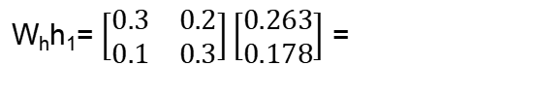


Step 5 — Process the Second Word
The second word is: attended
x2​=[0.1,0.6]
W_{x​}x_{2​}= $\left[\begin{matrix}0.5 & 0.1 \\ 0.2 & 0.4\end{matrix}\right]\left[\begin{matrix}0.1 \\ 0.6\end{matrix}\right]$ =
W_{x}​x₂​+W_{h}​h₁​=$$\left[\begin{matrix}0.221 \\ 0.3397\end{matrix}\right]$$
$$\left[\begin{matrix}0.11 \\ 0.26\end{matrix}\right]$$
$$\left[\begin{matrix}0.1144 \\ 0.0797\end{matrix}\right]$$
W_{h​}h_{1​}= $\left[\begin{matrix}0.3 & 0.2 \\ 0.1 & 0.3\end{matrix}\right]\left[\begin{matrix}0.263 \\ 0.178\end{matrix}\right]$ =

Slide 8
Encoder
Entire document
Conceptually
x₁→h_{1 ​}
x₂→h_{2 ​}
x₃→h_{3 ​}
x₄→h_{4 ​}
x₅→h_{5 ​}
Students attended the technology conference
↓
Encoder RNN
↓
h₅ =meaning/context of the sentence
​

Slide 9
Decoder
generates the summary one word at a time
Special tokens: <START> Students learned about technology <END>
The decoder receives: <START> and predicts: Students
Then it receives Students and predicts: learned
Then: learned -> about and so on.

Slide 10
Predicting the First Summary Word
Decoder starts with: <START>
The decoder uses the encoder's context vector.
Suppose the output vocabulary is:
V={Students,attended,technology,conference,learned,about,new}
Assume the decoder produces the following probability distribution:
Word | Probability
Students | 0.72
attended | 0.08
technology | 0.06
conference | 0.04
learned | 0.05
about | 0.03
new | 0.02
The highest probability is: Students
Therefore: <START>→Students

Slide 11
Predicting the Second and third Word
Word | Probability
attended | 0.1
technology | 0.05
learned | 0.65
about | 0.12
new | 0.05
conference | 0.03
Word | Probability
Students | 0.02
attended | 0.03
technology | 0.08
conference | 0.02
learned | 0.03
about | 0.72
new | 0.1
Therefore: learned
Summary so far: Students learned
Therefore: about
Summary: Students learned about

Slide 12
Predicting the Fourth Word and End token
Word | Probability
Students | 0.01
technology | 0.61
conference | 0.04
learned | 0.02
about | 0.03
new | 0.21
Token | Probability
Students | 0.01
learned | 0.02
about | 0.01
technology | 0.03
<END> | 0.93
Therefore: technology
Summary: Students learned about technology
Since: P(<END>)=0.93 the decoder stops.

Slide 13
Final Summary
Input : Students attended the technology conference.
Generated summary : Students learned about technology.
This is abstractive summarization because the generated summary does not simply copy a sentence from the input. The model generates a new sequence based on the learned representation.

Slide 14
Back Propagation Through Time (BPTT)
The model's predicted probability distribution is compared with the correct word using cross-entropy loss.
For one word: L=-logP(y_{t})
For example, if the correct word is learned and the model predicts: P(learned)=0.65
then: L=-log(0.65) ≈ 0.431
The model uses backpropagation through time (BPTT) to update its weights.

Slide 15
Limitation of Basic RNN Summarization
The basic encoder-decoder RNN compresses the entire input into one final hidden state: h_{T} For a long document, this becomes a bottleneck.
For example:
100-word document
↓
200-word document
↓
1000-word document
↓
ONE context vector
Important information may be lost.
This led to the development of: RNN Encoder-Decoder + Attention
With attention, the decoder can look at different encoder hidden states while generating each summary word.

Slide 16
RNN vs Attention-Based RNN
Basic RNN | RNN + Attention
Uses one final context vector | Uses all encoder states
Information bottleneck | Reduces bottleneck
Difficult for long documents | Better for long documents
Simpler architecture | More computationally expensive
Earlier summarization approach | Improved sequence-to-sequence approach

